Slide 1
New VGAE model
New VGAE model: Flawless1202/VGAE_pyG: An VGAE implementation using pytorch geometric. (github.com)
Input: 30 graphs with 10 nodes
Optimizers: Adams optimizer with learning rate 0.001
Epoches: 1000000 epoches
Latent space: 2 out-channels

Slide 2
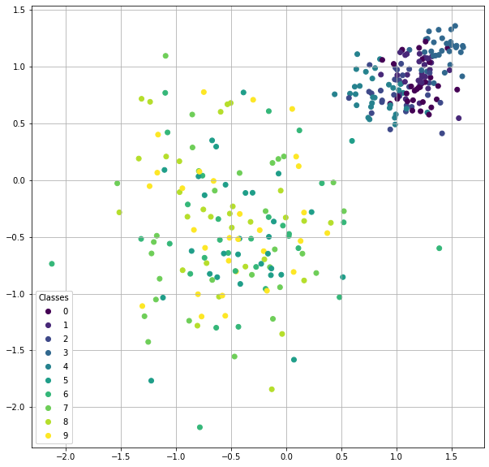
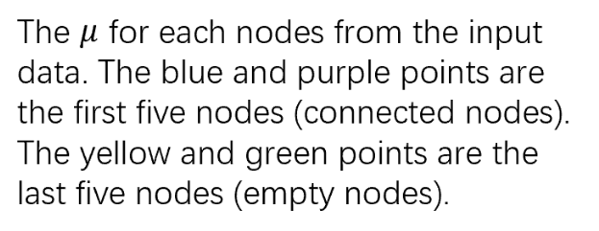

Slide 3
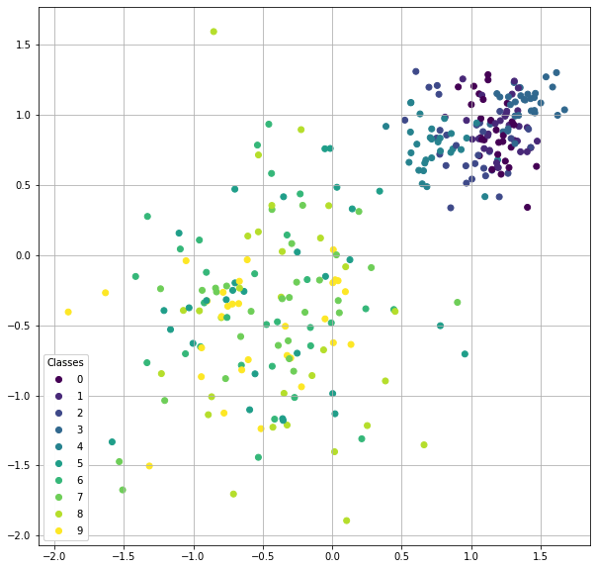
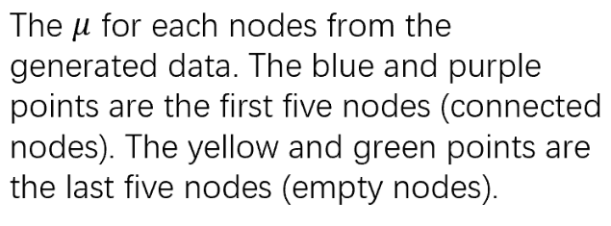

Slide 4
input
generated

Slide 5
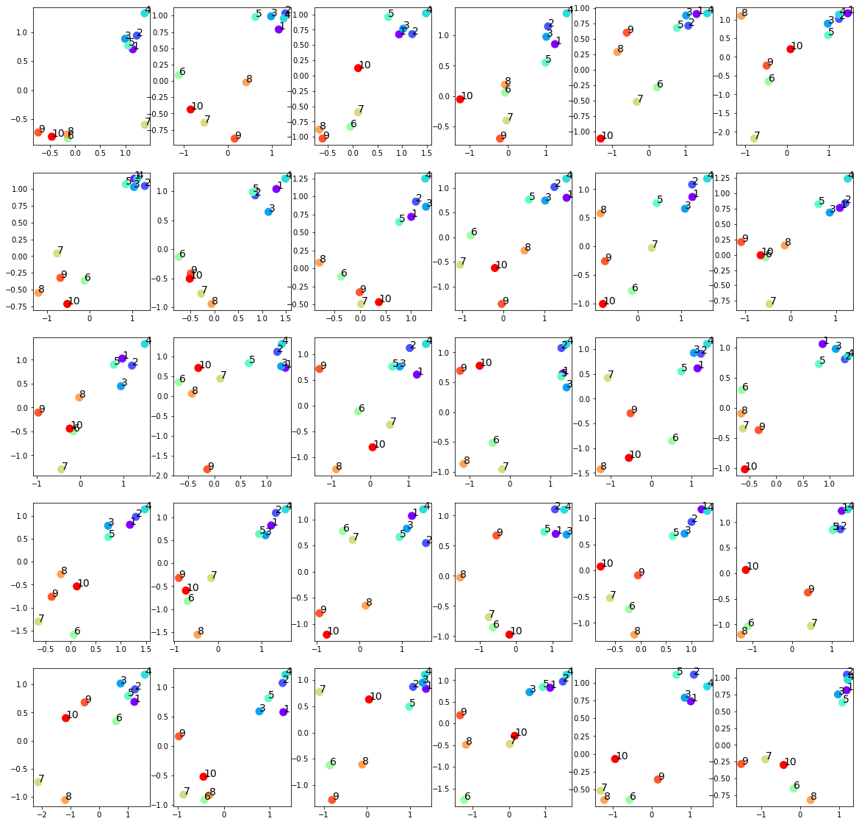
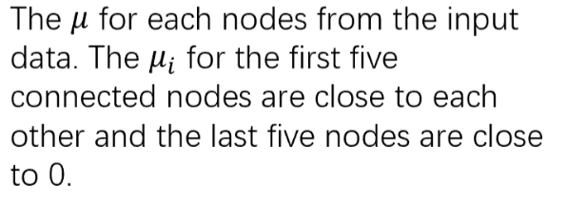

Slide 6
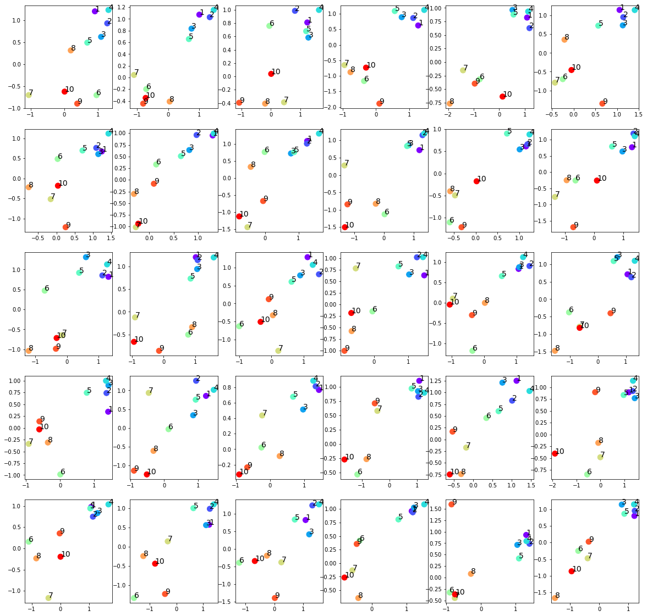
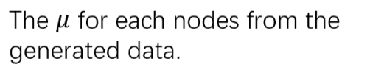

Slide 7
input
generated

Slide 8
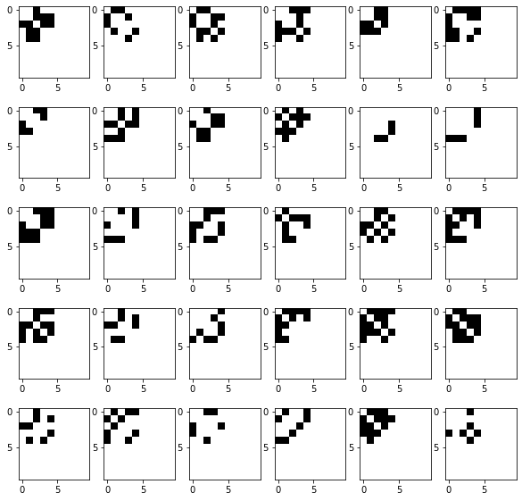
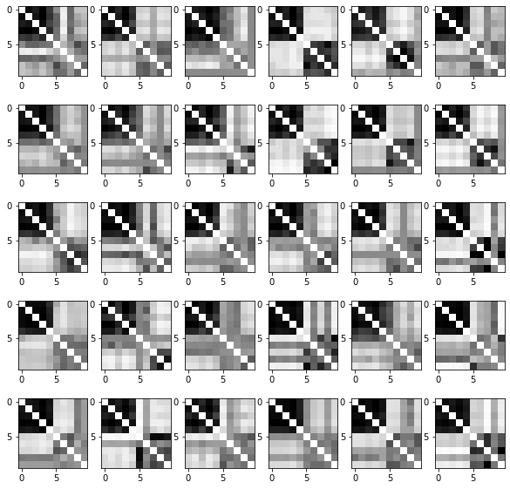
Input adjacency matrices (p=0.5)
Raw generated adjacency matrices (filter_value=0)

Slide 9
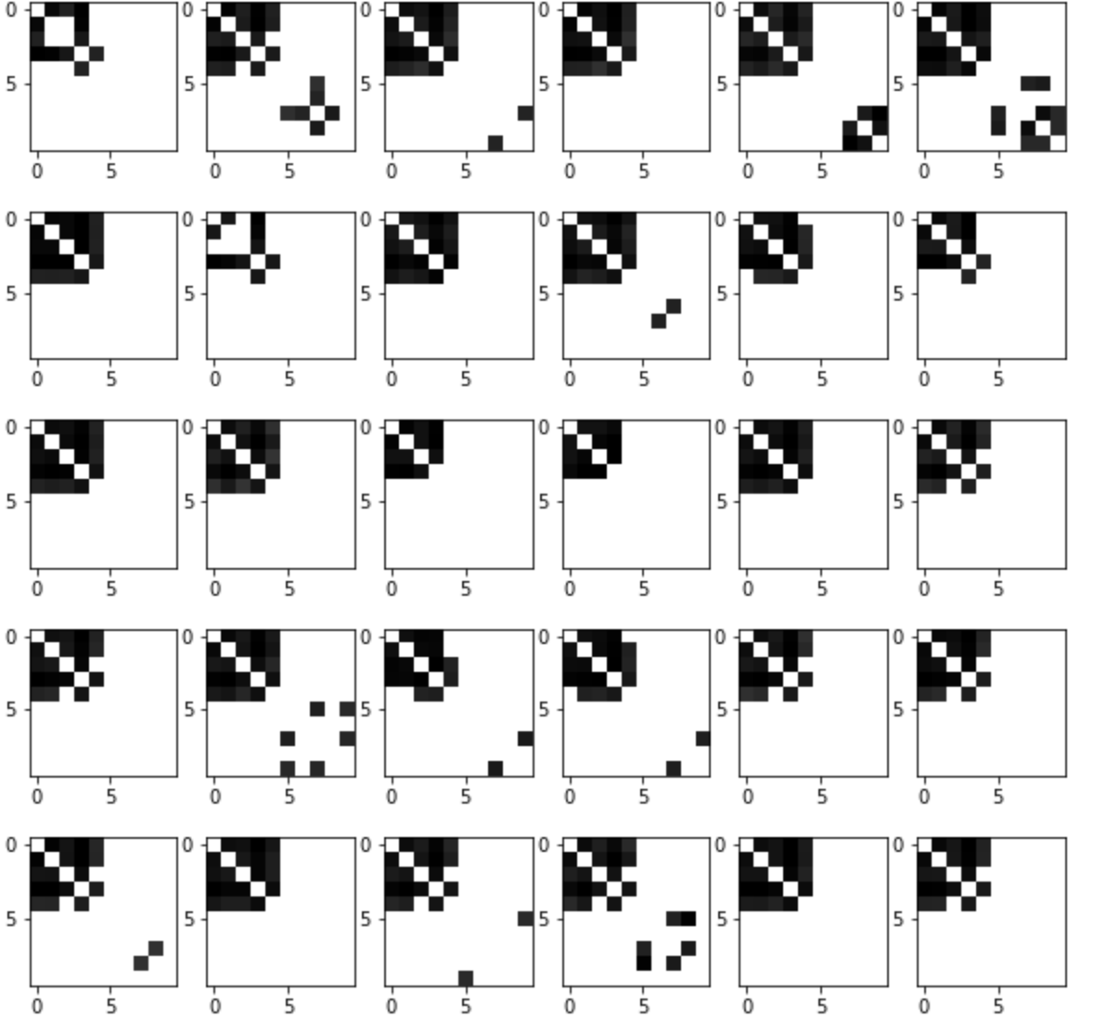
Input adjacency matrices (p=0.5)
generated adjacency matrices (filter_value=0.5)

Slide 10
Normalized Centrality
Node index | 1 | 2 | 3 | 4 | 5 | 6 | 7 | 8 | 9 | 10
Generated matrices centrality | 0.33 | 0.34 | 0.30 | 0.36 | 0.26 | 0.02 | 0.01 | 0.03 | 0.01 | 0.02
Original matrices centrality | 0.19 | 0.19 | 0.17 | 0.20 | 0.22 | 0. | 0. | 0. | 0. | 0.

Slide 11
New VGAE model
New VGAE model: Flawless1202/VGAE_pyG: An VGAE implementation using pytorch geometric. (github.com)
Input: 30 graphs with 10 nodes
Optimizers: Adams optimizer with learning rate 0.001
Epoches: 1000000 epoches
Latent space: 2 out-channels
p = 0.8 for the upper left submatrix

Slide 12
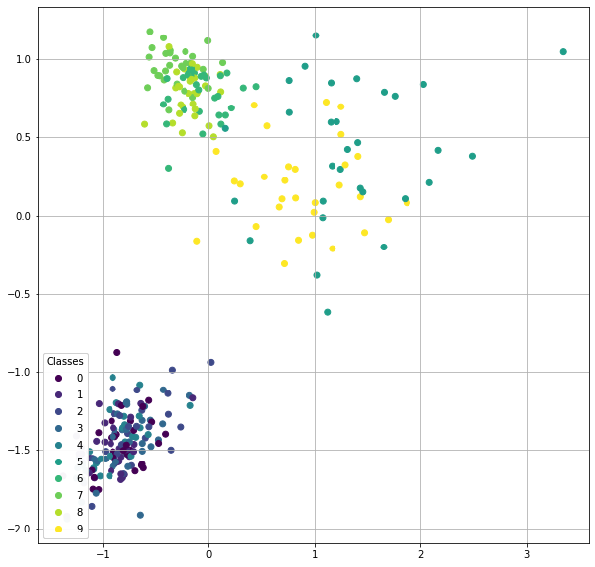

Slide 13
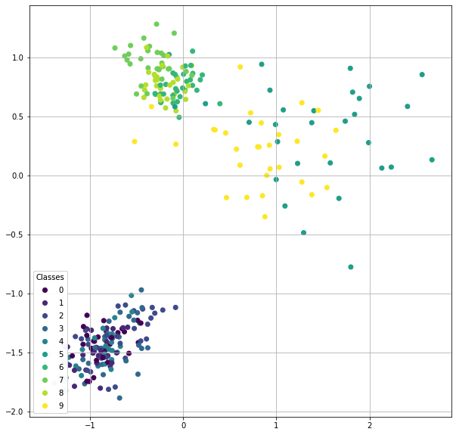

Slide 14
input
generated

Slide 15
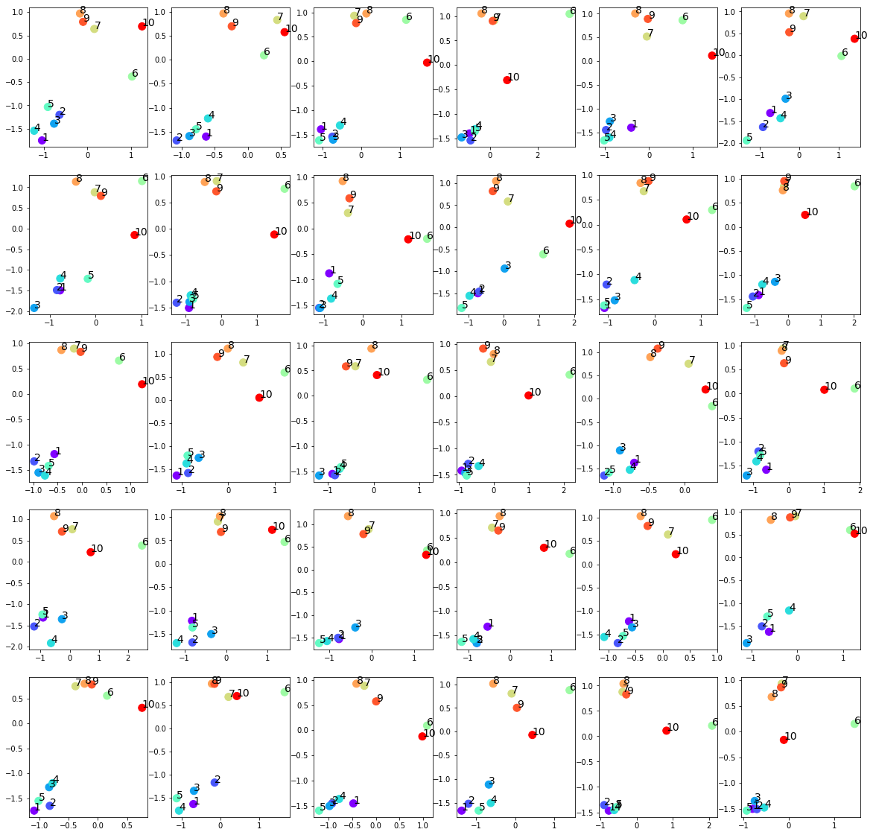

Slide 16
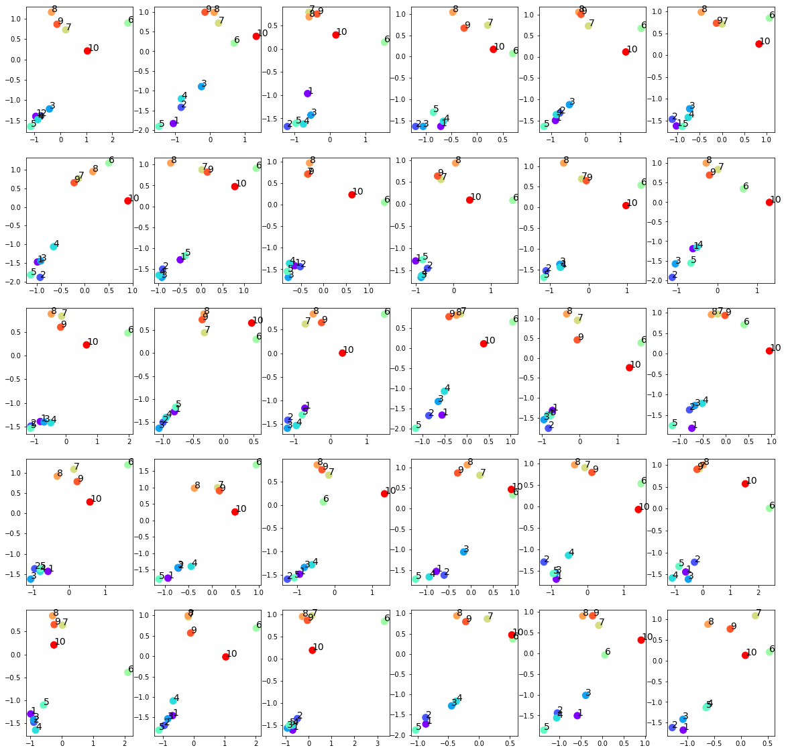

Slide 17
input
generated

Slide 18
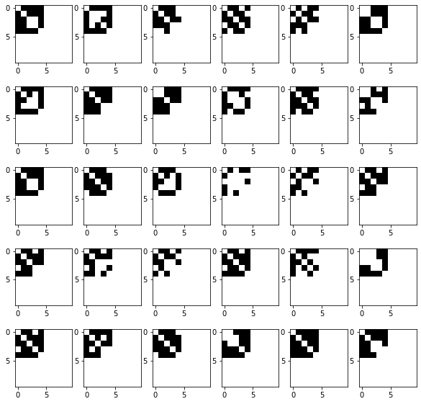
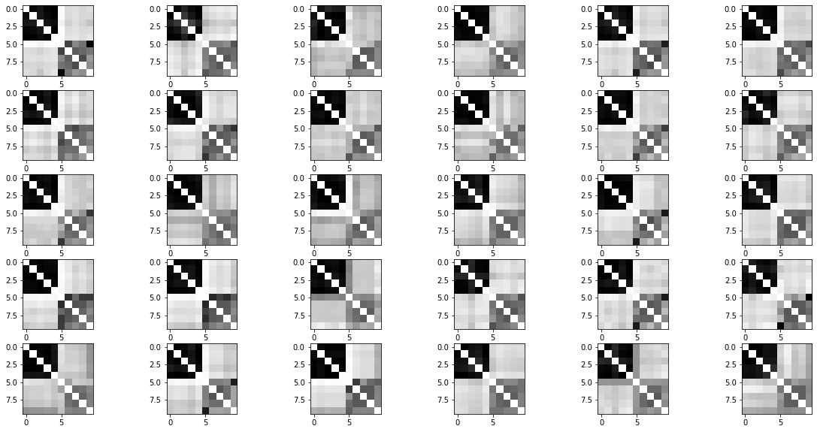
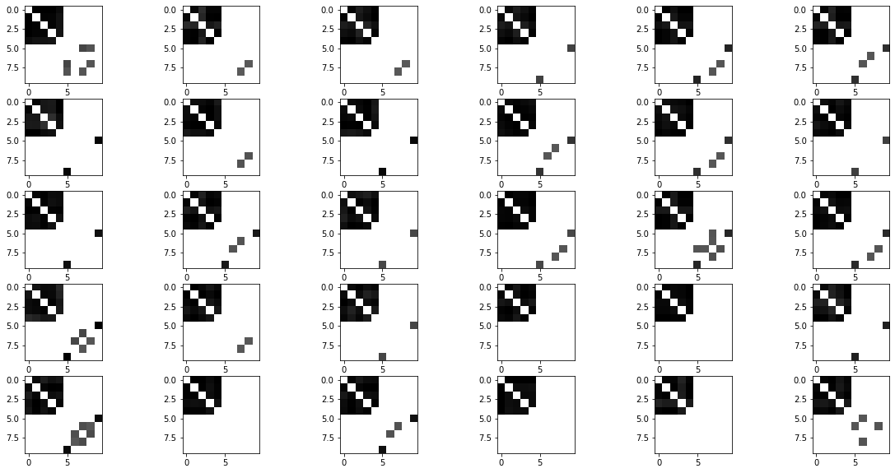
Raw generated adjacency matrices (filter_value=0)
Input adjacency matrices (p=0.8)
Generated adjacency matrices (filter_value=0.5)

Slide 19
Normalized Centrality
Node index | 1 | 2 | 3 | 4 | 5 | 6 | 7 | 8 | 9 | 10
Generated matrices centrality | 0.37 | 0.34 | 0.36 | 0.37 | 0.37 | 0.06 | 0.02 | 0.05 | 0.03 | 0.05
Original matrices centrality | 0.32 | 0.34 | 0.30 | 0.32 | 0.31 | 0. | 0. | 0. | 0. | 0.

Slide 20
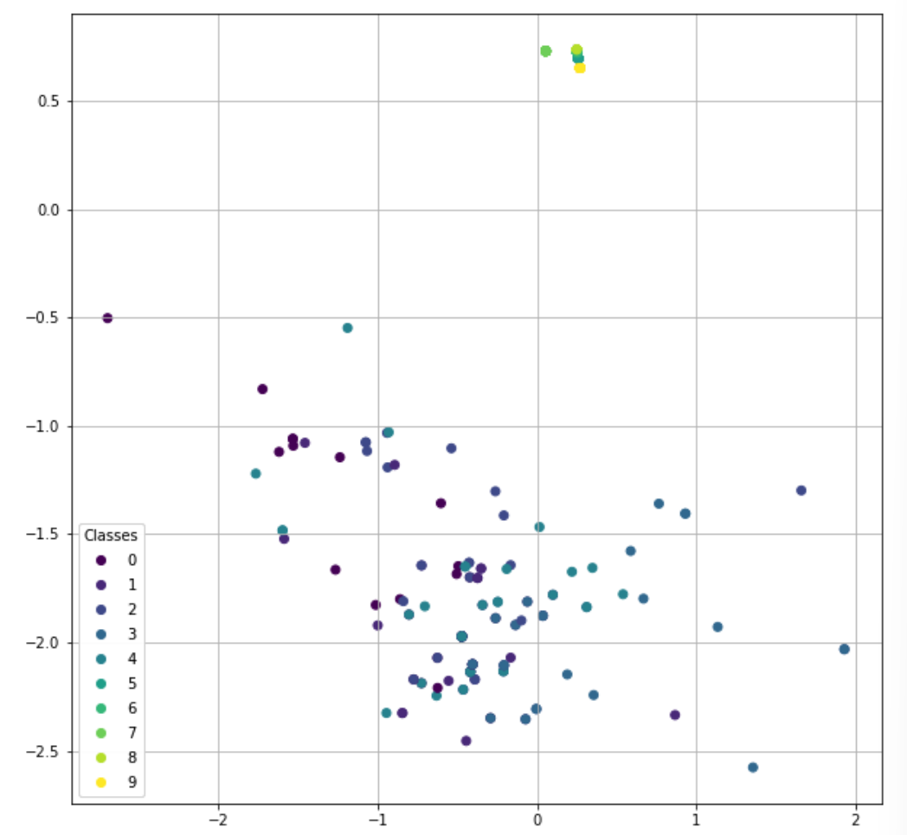
Another pattern:
The last five nodes over-concentrate around 0
No effect on the first five nodes
Easier to happen when setting lower learning rate

Slide 21
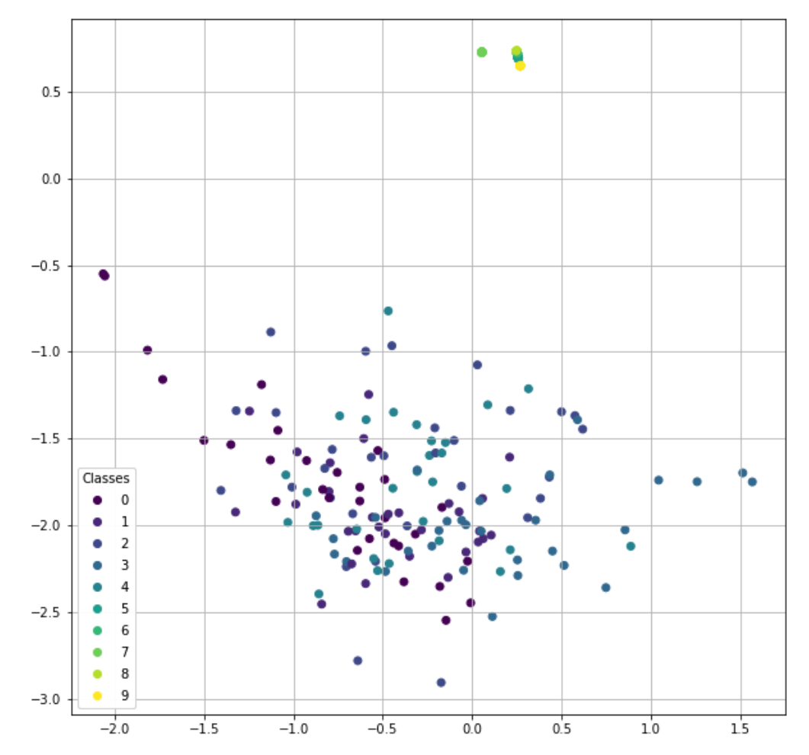

Slide 22
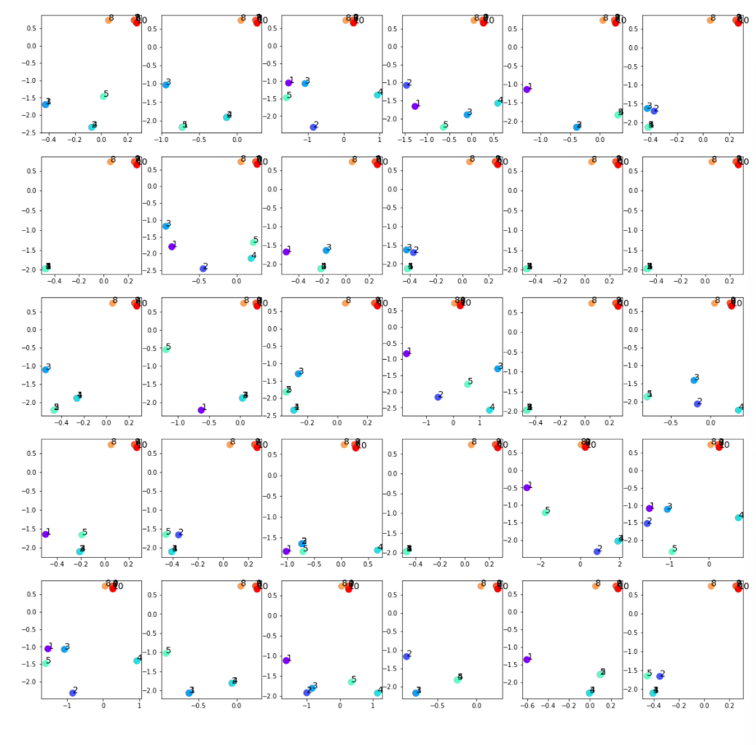

Slide 23
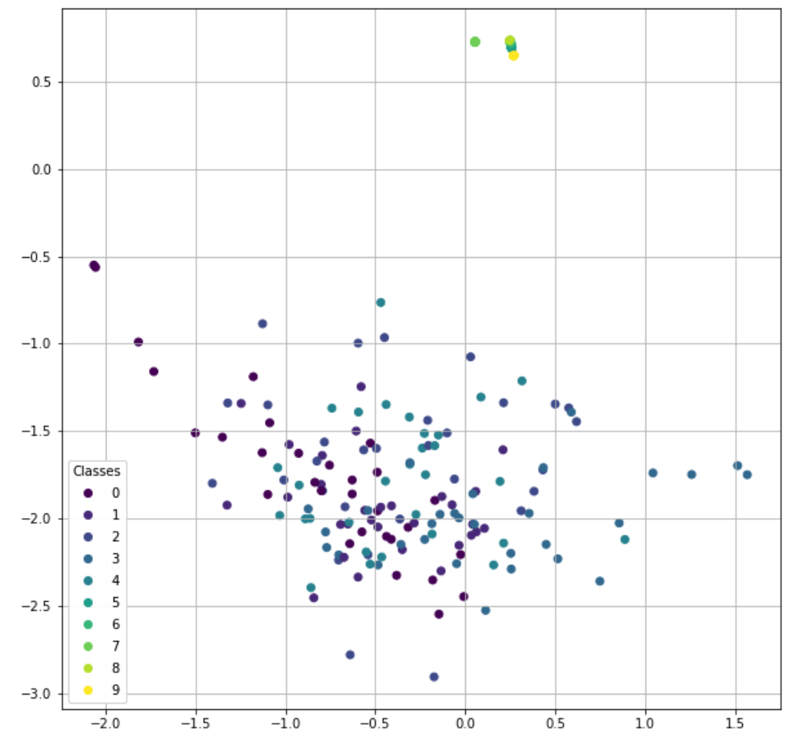

Slide 24
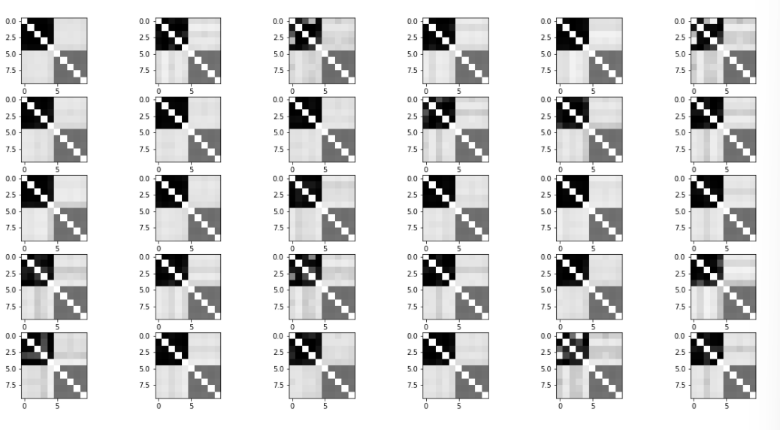
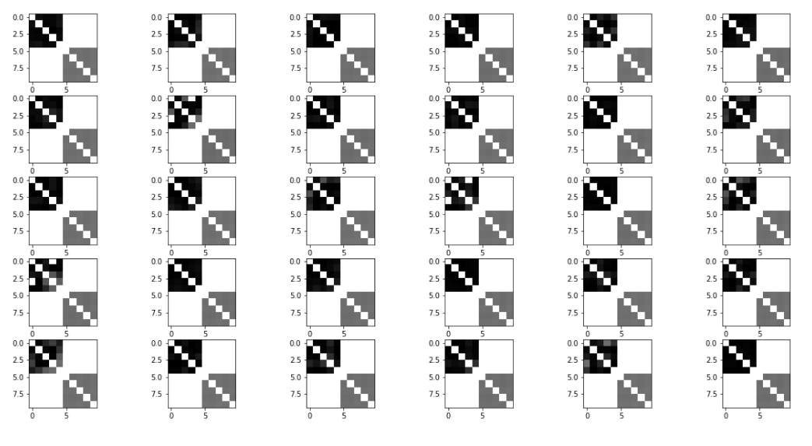
Raw generated adjacency matrices (filter_value=0)
Input adjacency matrices (p=0.8)
Generated adjacency matrices (filter_value=0.5)

Slide 25
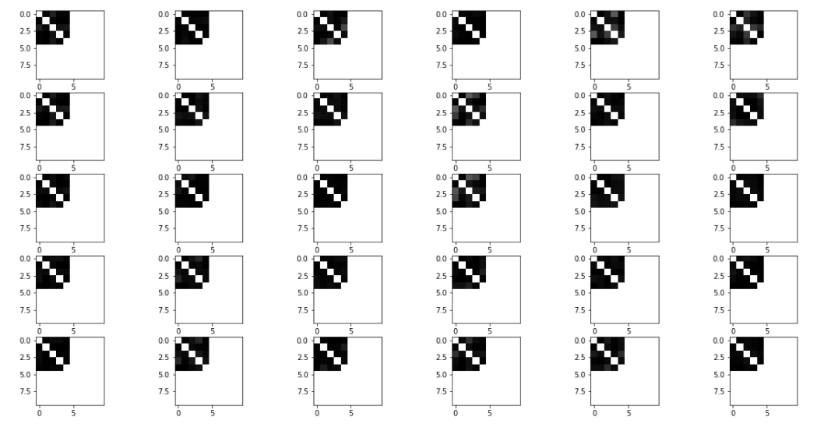
Generated adjacency matrices (filter_value=0.5)
Generated adjacency matrices (filter_value=0.7)

Slide 26
Node index | 1 | 2 | 3 | 4 | 5 | 6 | 7 | 8 | 9 | 10
Generated matrices centrality(filter_value=0.5) | 0.37 | 0.34 | 0.36 | 0.37 | 0.37 | 0.06 | 0.02 | 0.05 | 0.03 | 0.05
Original matrices centrality | 0.32 | 0.34 | 0.30 | 0.32 | 0.31 | 0. | 0. | 0. | 0. | 0.
Node index | 1 | 2 | 3 | 4 | 5 | 6 | 7 | 8 | 9 | 10
Generated matrices centrality(filter_value=0.7) | 0.38 | 0.38 | 0.37 | 0.38 | 0.38 | 0 | 0 | 0 | 0 | 0
Generated matrices centrality(filter_value=0.5) | 0.38 | 0.38 | 0.37 | 0.38 | 0.38 | 0.25 | 0.25 | 0.25 | 0.25 | 0.25
Original matrices centrality | 0.32 | 0.34 | 0.30 | 0.32 | 0.31 | 0. | 0. | 0. | 0. | 0.

Slide 27
p=0.25 simulation
Input: 30 graphs with 10 nodes
Optimizers: Adams optimizer with learning rate 0.001
Epoches: 1000000 epoches
Latent space: 2 out-channels
p = 0.25 for the upper left submatrix

Slide 28
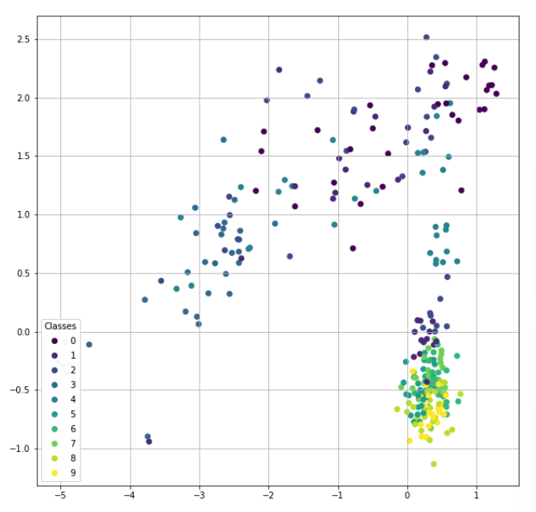

Slide 30
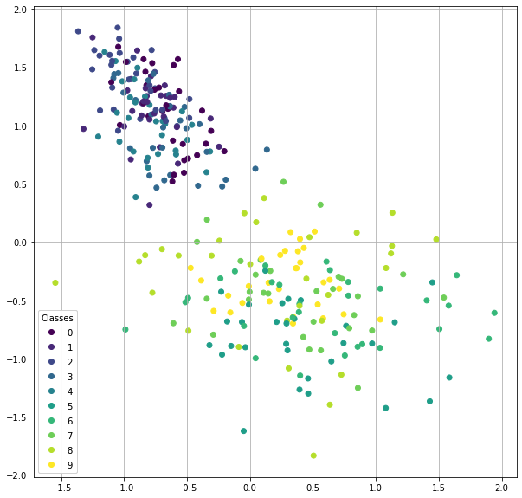
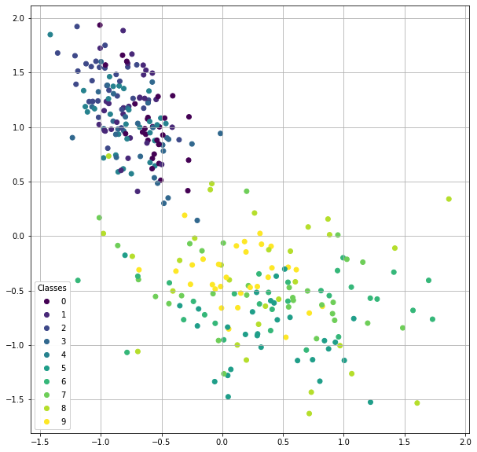
input
generated

Slide 31
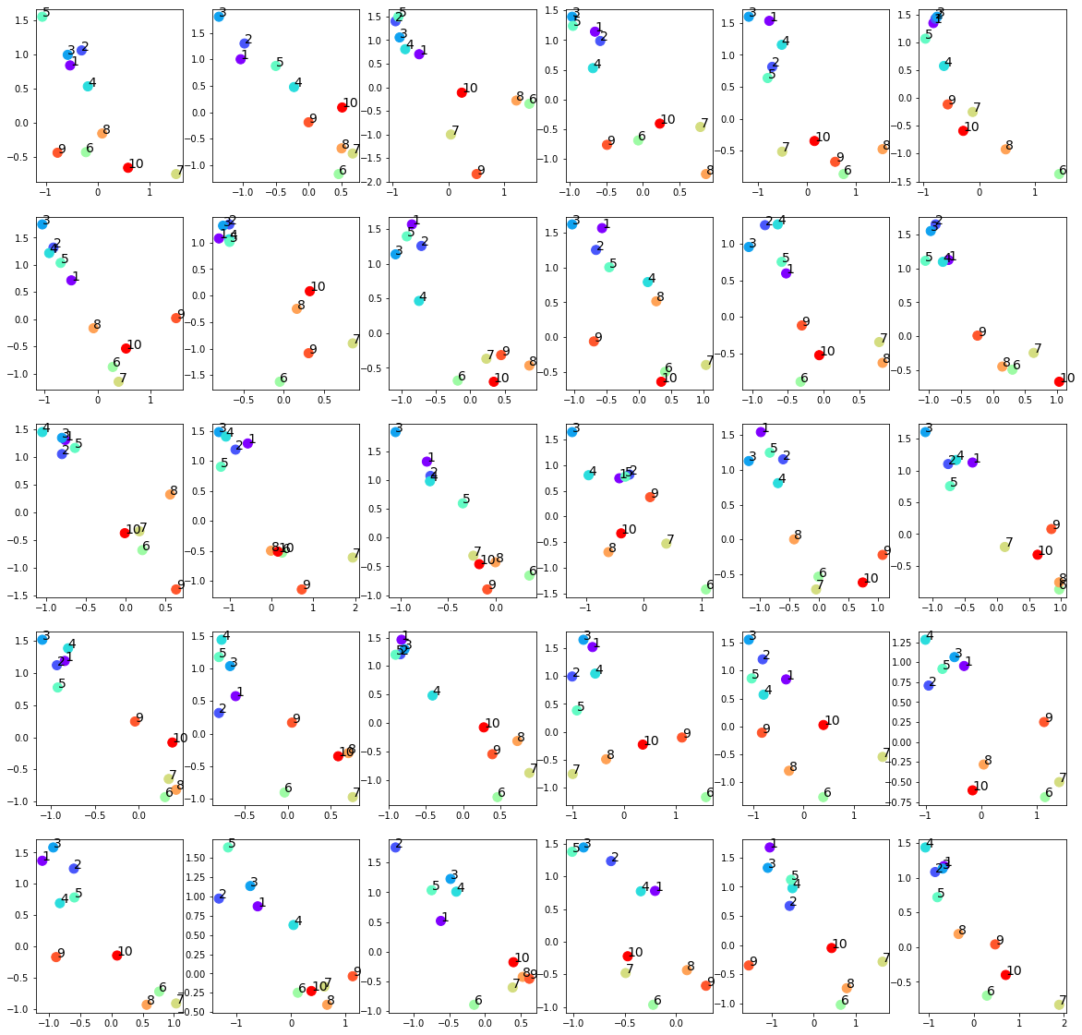

Slide 32
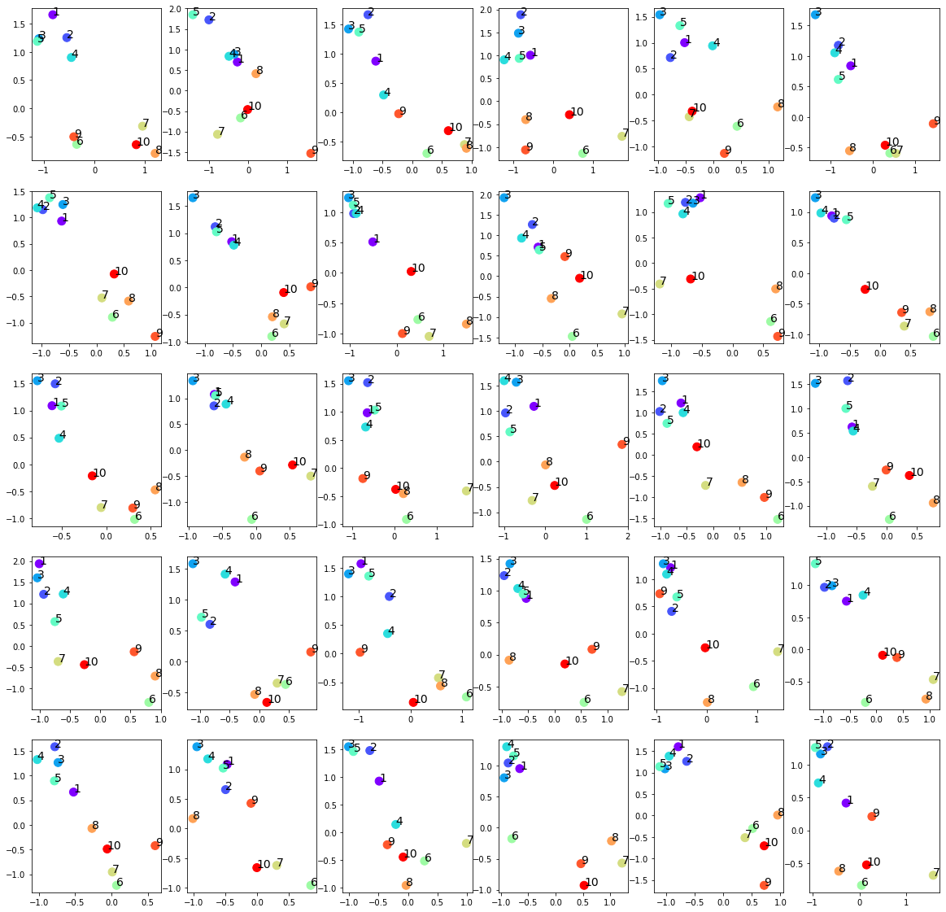

Slide 33
input
generated

Slide 34
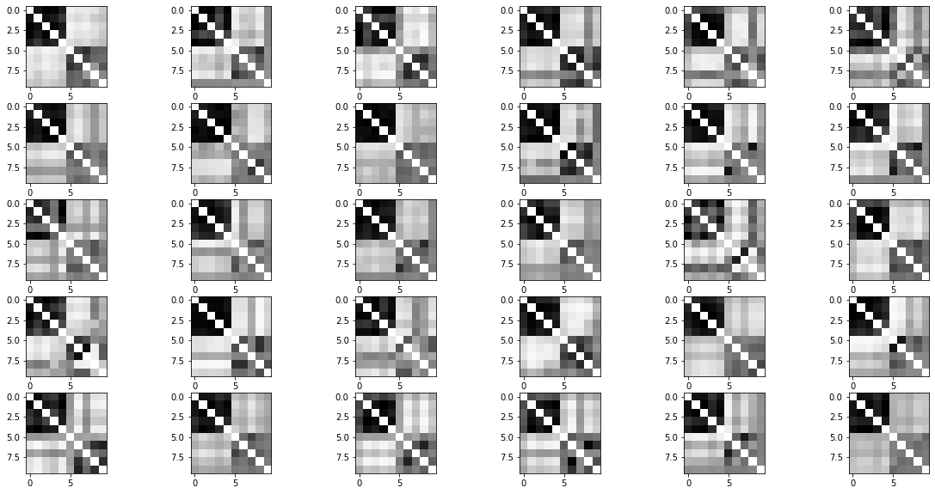
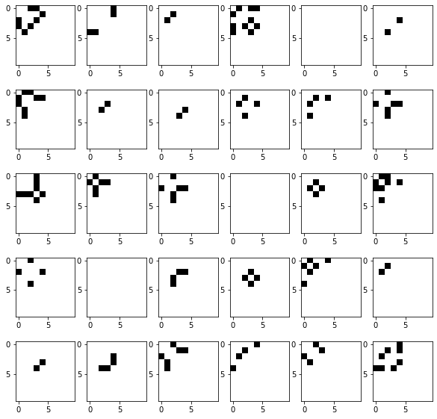
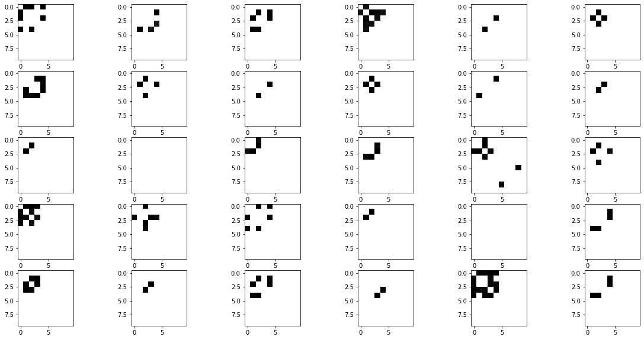
Raw generated adjacency matrices (filter_value=0)
Input adjacency matrices (p=0.25)
Generated adjacency matrices (filter_value=0.7)

Slide 35
Normalized Centrality
Node index | 1 | 2 | 3 | 4 | 5 | 6 | 7 | 8 | 9 | 10
Generated matrices centrality | 0.13 | 0.13 | 0.17 | 0.12 | 0.13 | 0.003 | 0.00 | 0.004 | 0.00 | 0.00
Original matrices centrality | 0.12 | 0.13 | 0.09 | 0.10 | 0.10 | 0.0 | 0.0 | 0.0 | 0.0 | 0.0

Slide 36
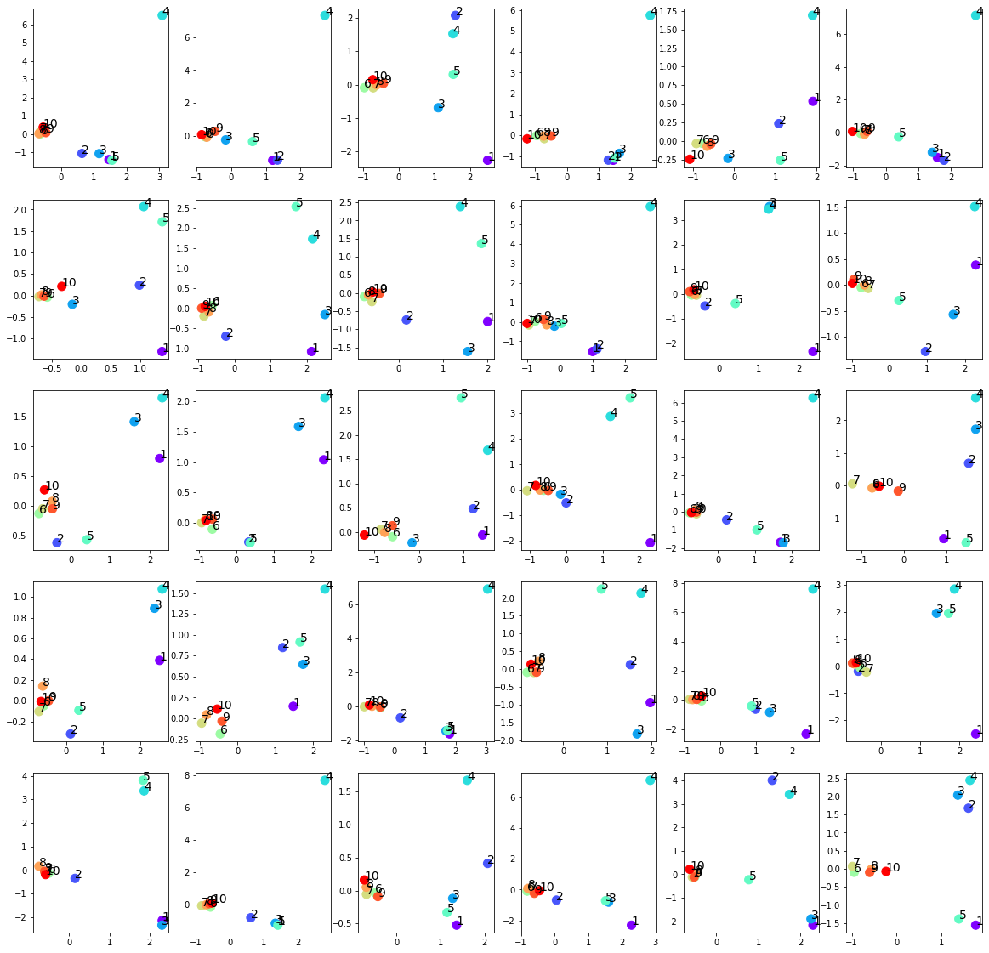
Failed trainings
Settings:
Input: 30 graphs with 10 nodes
Optimizers: Adams optimizer with learning rate 0.01
Epoches: 1000000 epoches
Latent space: 2 out-channels
p = 0.25 for the upper left submatrix
The last five nodes over-concentrate around 0
No effect on the first five nodes
Easier to happen when setting p<0.5

Slide 37
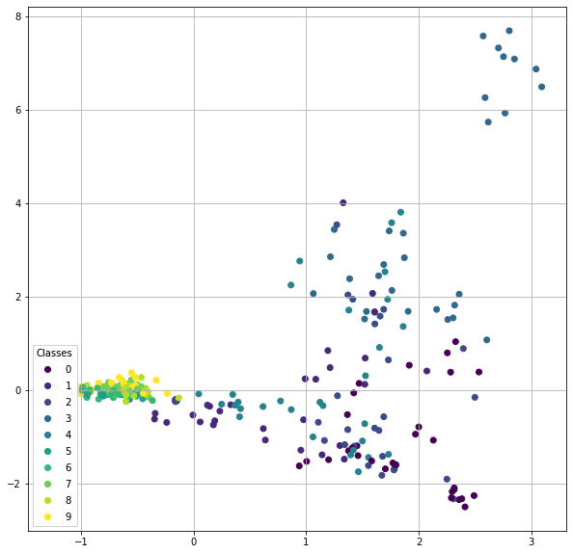
Another pattern
Settings:
Input: 30 graphs with 10 nodes
Optimizers: Adams optimizer with learning rate 0.01
Epoches: 1000000 epoches
Latent space: 2 out-channels
p = 0.25 for the upper left submatrix

Slide 38
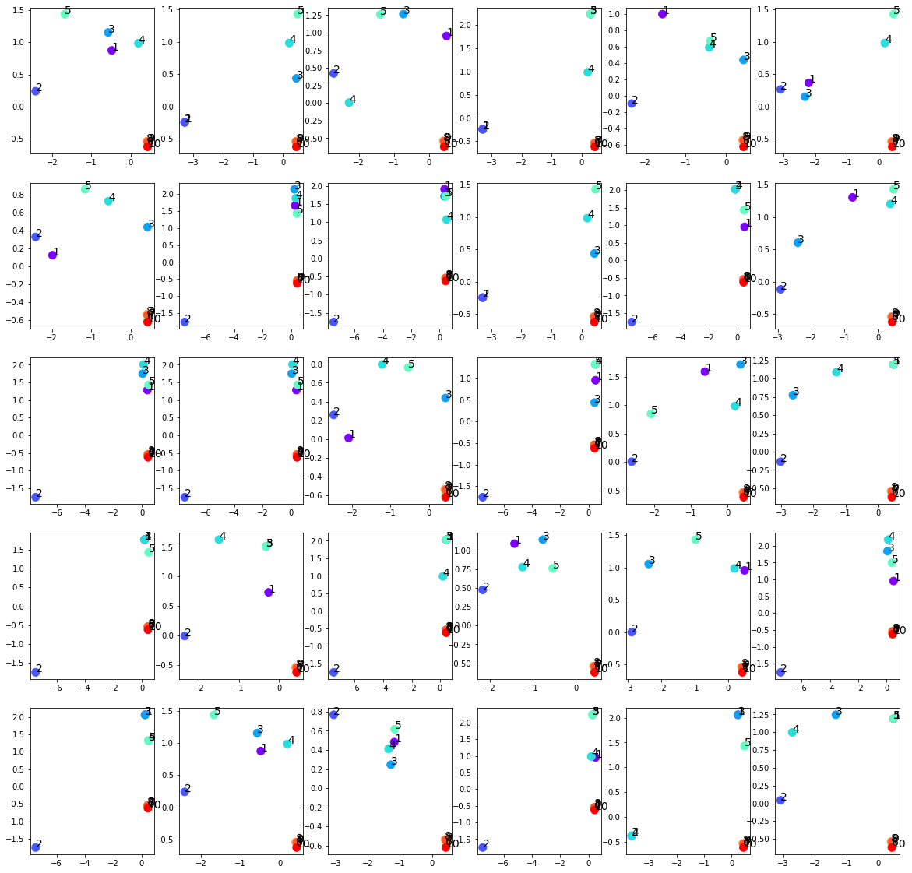

Slide 39
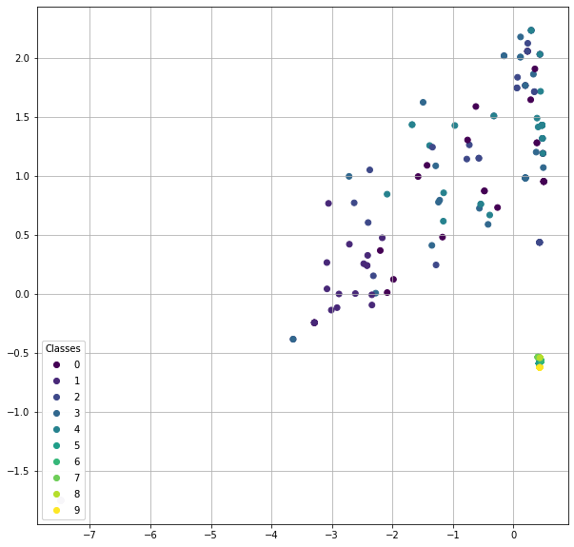

Slide 40
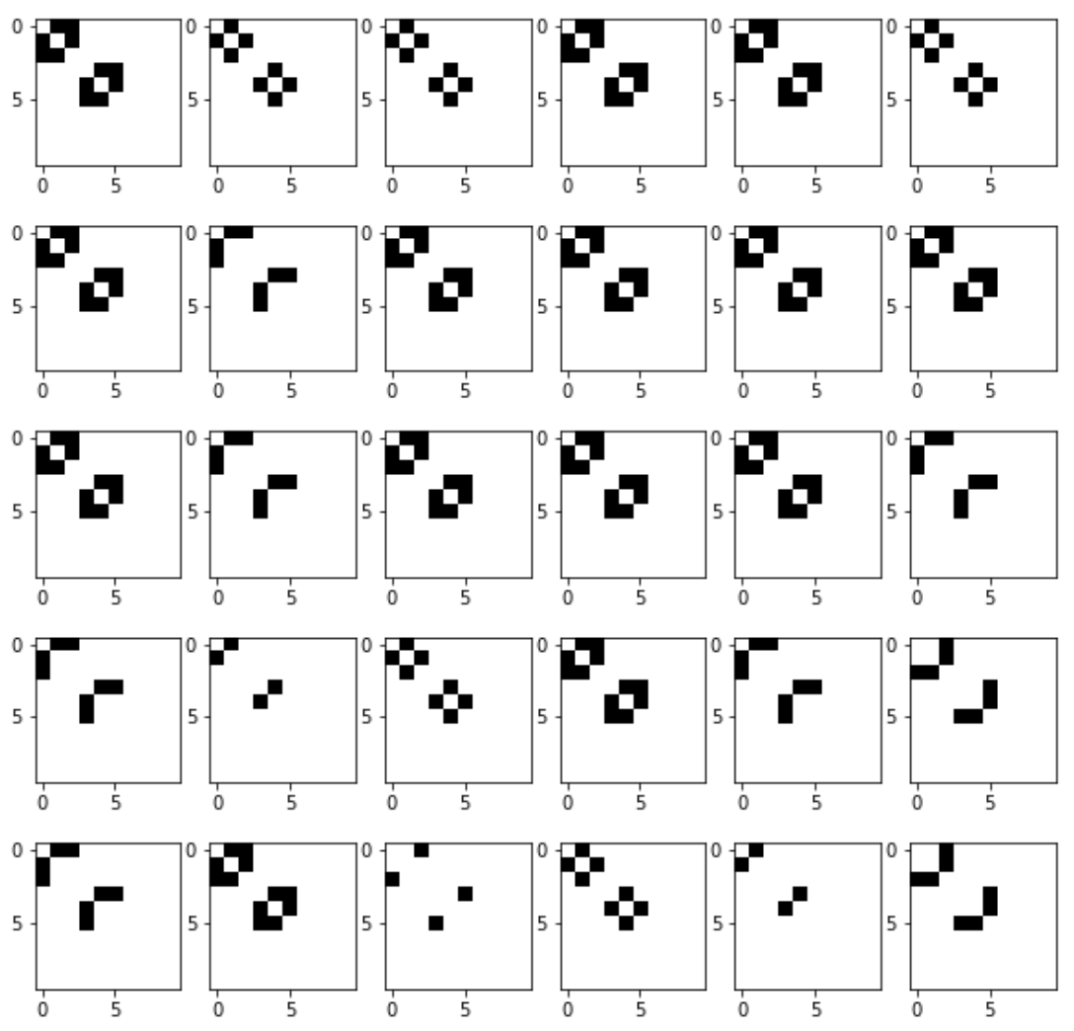

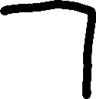
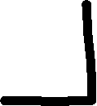

Slide 41
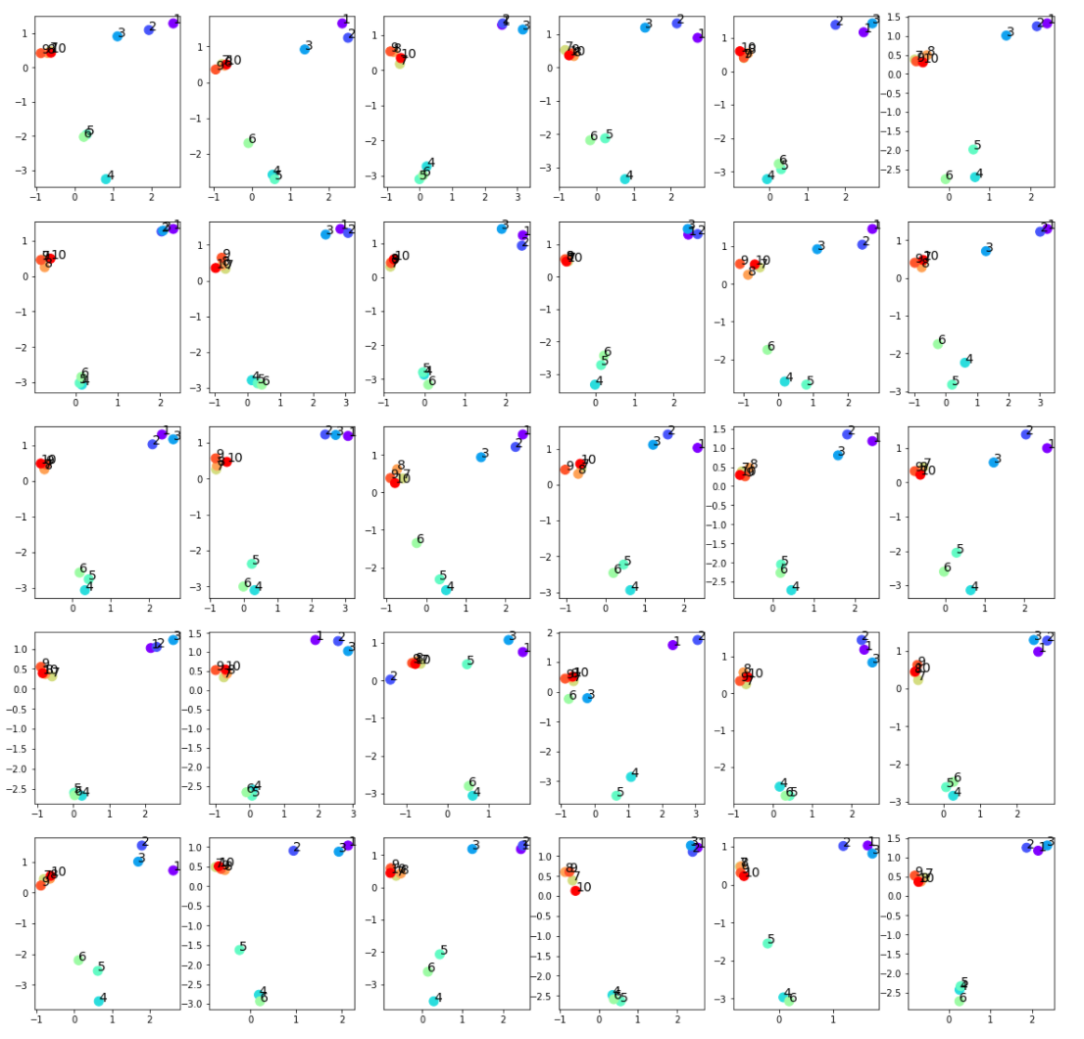
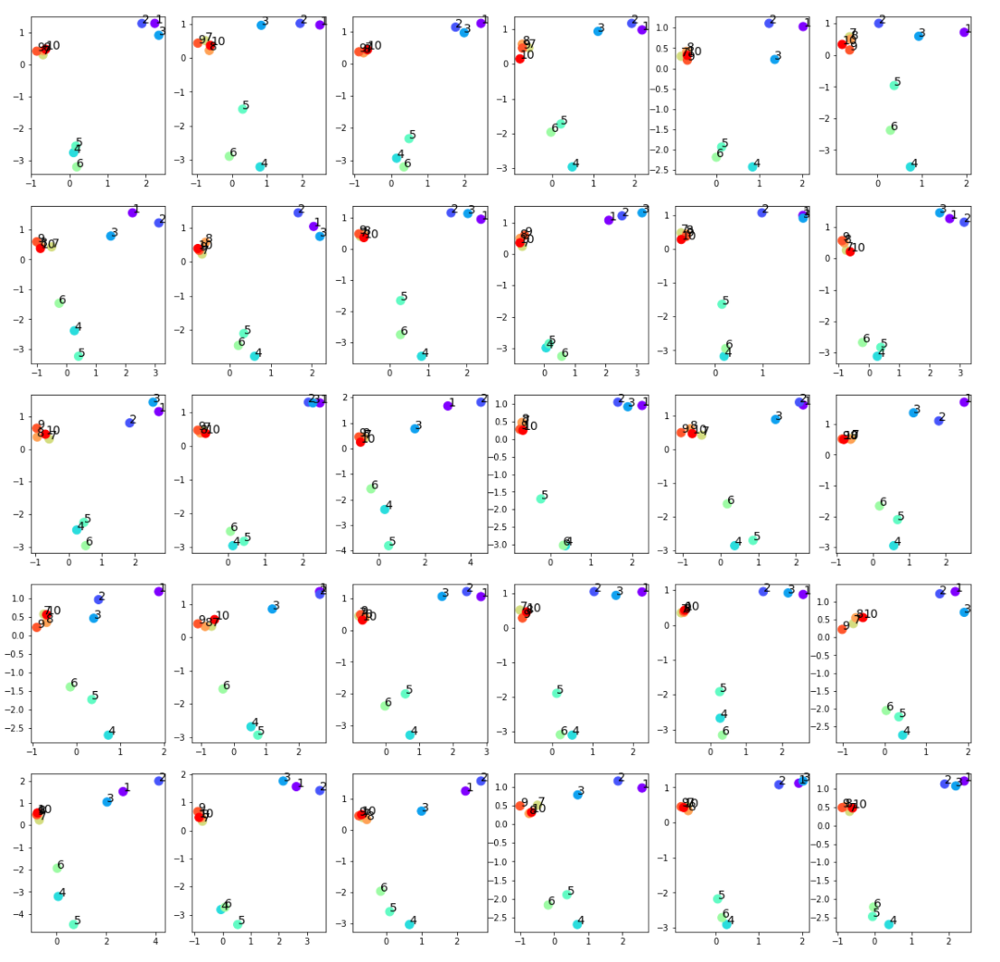
input
generated

Slide 42
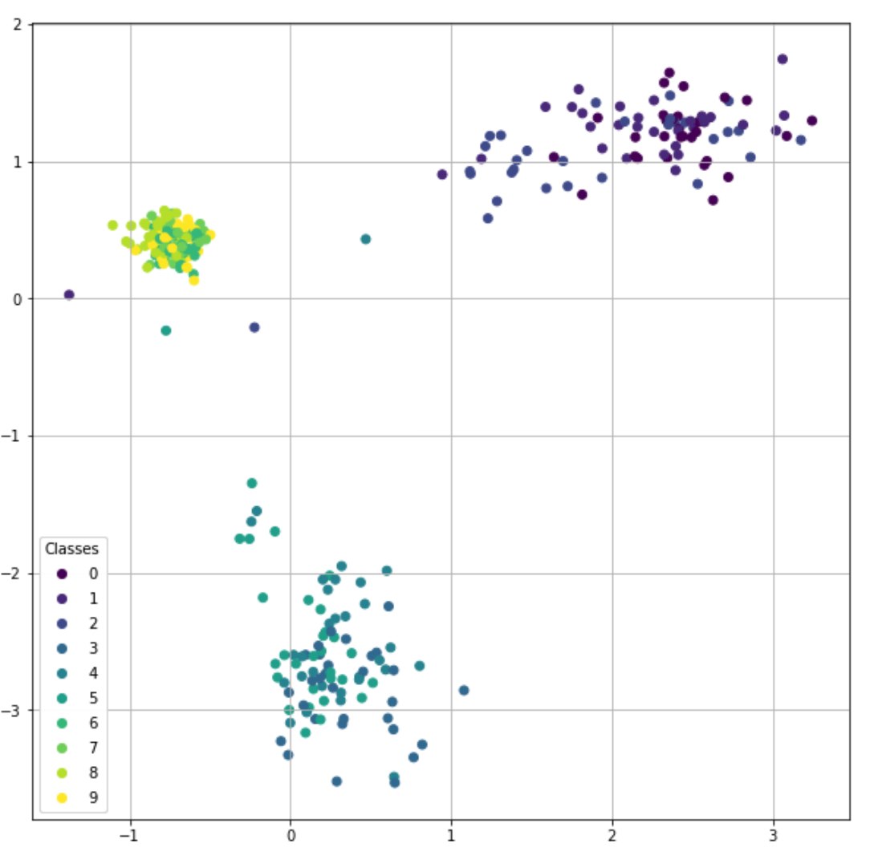
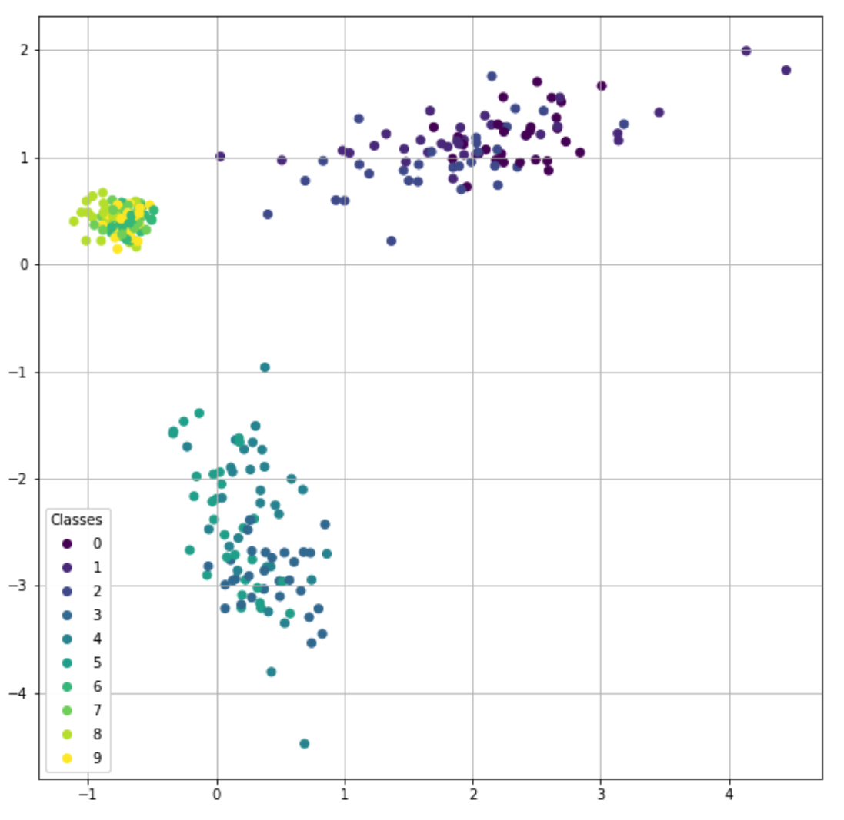
input
generated

Slide 43
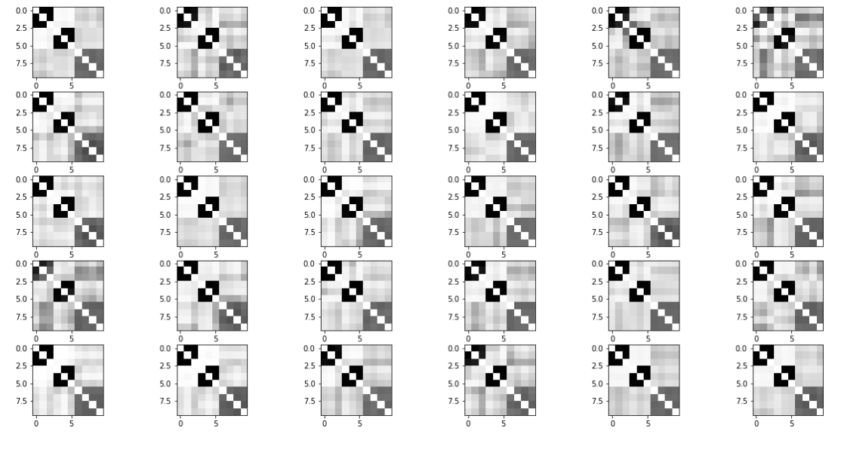
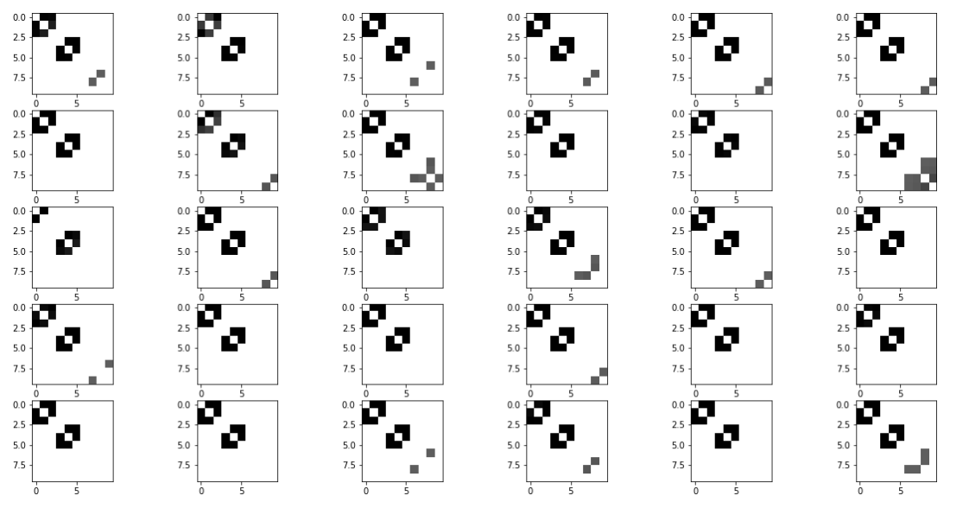
Raw generated adjacency matrices (filter_value=0)
Input adjacency matrices
Generated adjacency matrices (filter_value=0.5)

Slide 44
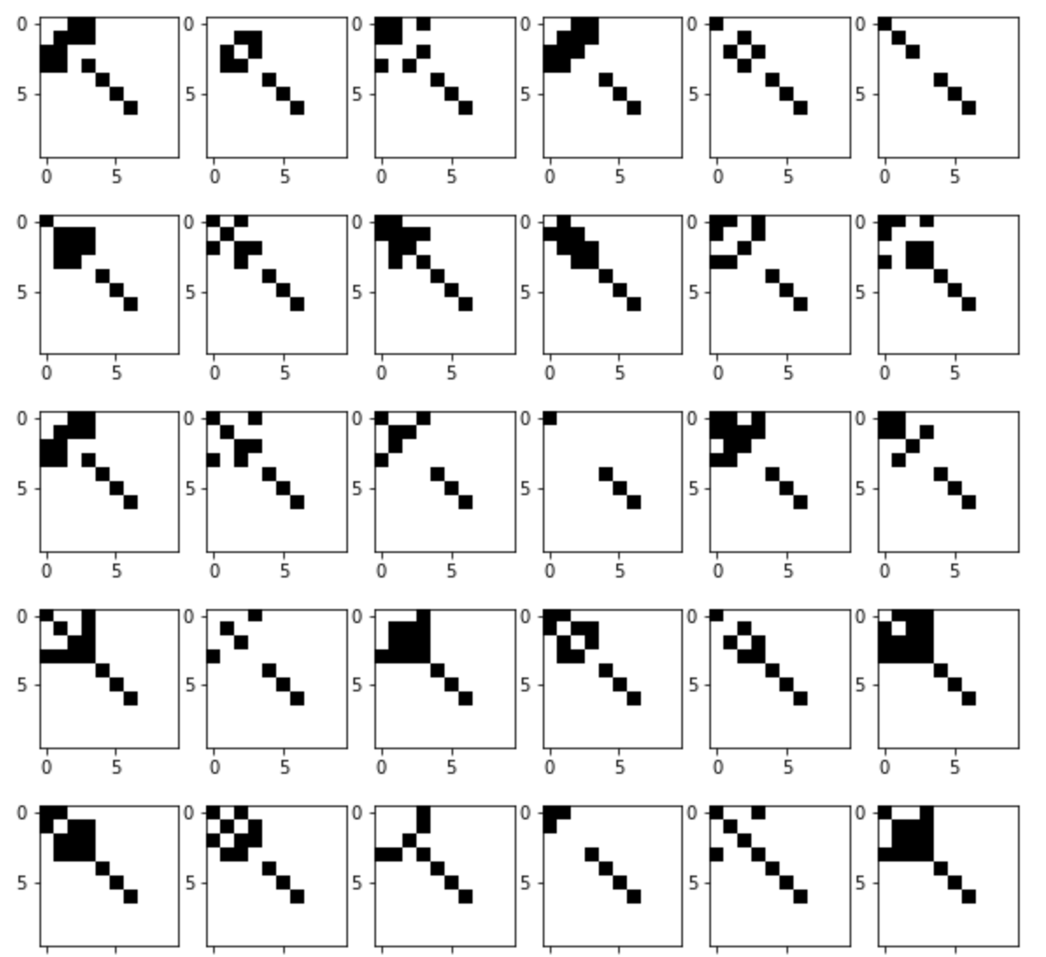
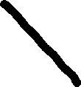
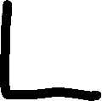
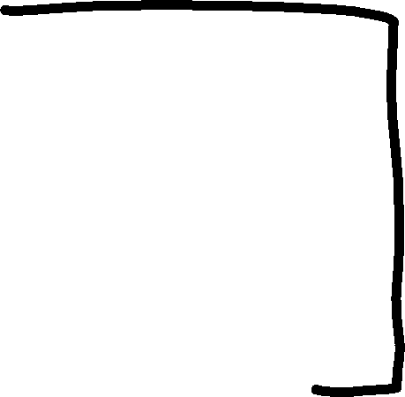






Slide 45


input
generated

Slide 46


input
generated

Slide 47


Raw generated adjacency matrices (filter_value=0)
Input adjacency matrices
Generated adjacency matrices (filter_value=0.5)

Slide 48




Slide 49


input
generated

Slide 50


input
generated

Slide 51


Raw generated adjacency matrices (filter_value=0)
Input adjacency matrices
Generated adjacency matrices (filter_value=0.5)

Slide 52

New sampling strategy
Fit $N$ (node number) Gaussian distribution $𝒩_{i}$ from each of $N$ rows of $\left\{μ_{i}\right\}.$
Sample $N μ_{i, sample}$ from the $N$Gaussian distribution $𝒩_{i}$.
Concatenate the $N μ_{i, sample}$ by row to get $μ_{sample}$.

Slide 53




Sampled $μ$ for each nodes generated by the old sampling algorithm.
Sampled $μ$ for each nodes generated by the new sampling algorithm.

Slide 54




Sampled $μ$ for each nodes generated by the old sampling algorithm.
Sampled $μ$ for each nodes generated by the new sampling algorithm.

Slide 55


The generated adjacency matrices by the old sampling algorithm.
The generated adjacency matrices by the new sampling algorithm.

